Slide 1
IRB Turn-around Times
2014

Slide 2
Number of approvals/determinations per application type
Not Human Subjects Research
34
Exempt
102
Expedited Review
55
Full Board
13

Slide 4
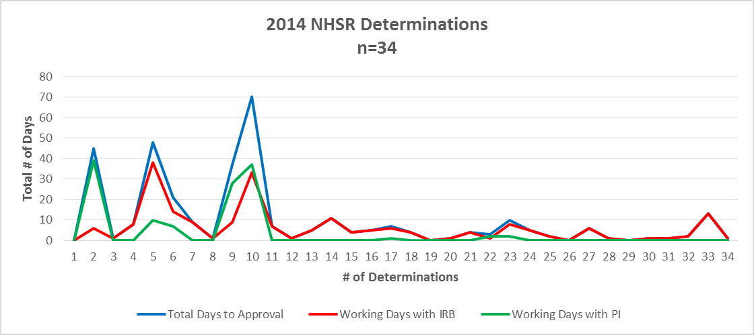

Slide 6
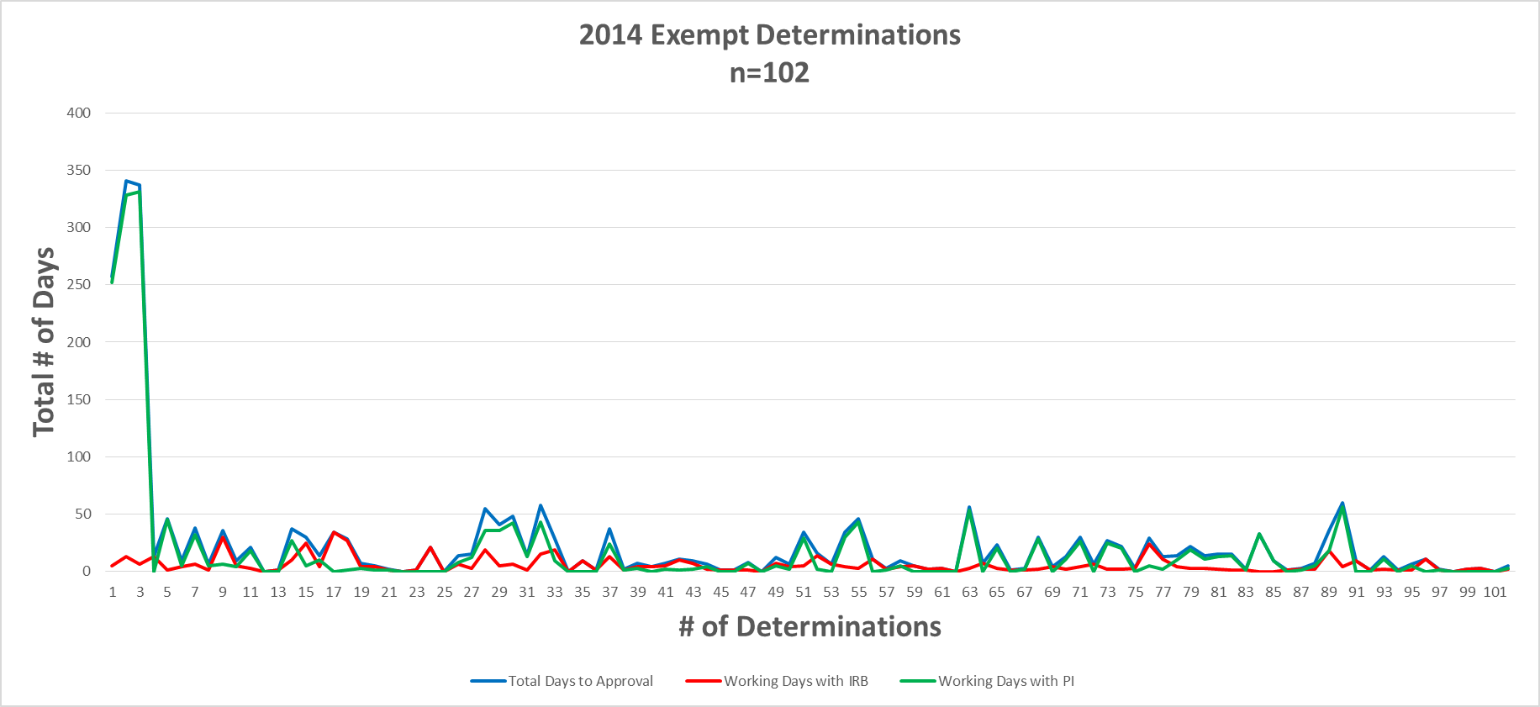

Slide 8
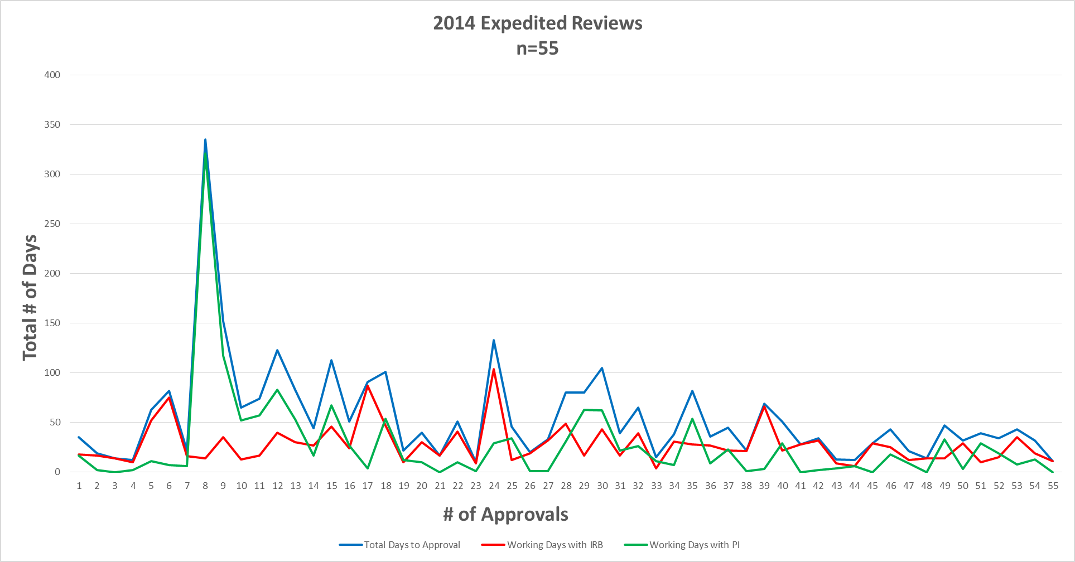

Slide 10
